Slide 1


Slide 2
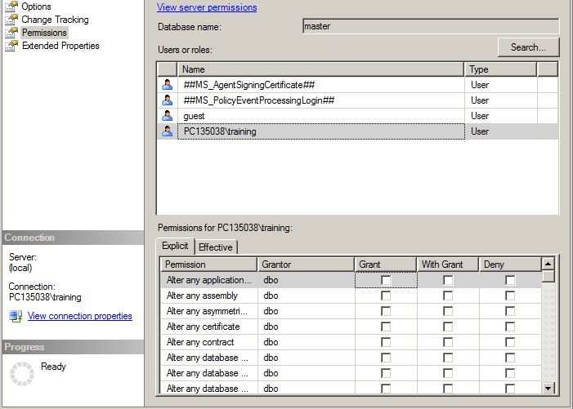

Slide 3
Explicit Permissions vs Effective Permissions
A user’s effective permissions to a specific object consists of the permissions explicitly granted to the user and the permissions derived from the user groups that the user belongs to.

Slide 4
Example
User1 is a member of Group A
User2 is a member of Group A and Group B
Group A - SELECT permission
Group B - INSERT permission
If no permission is granted explicitly to User1 and User2, their explicit permissions is none.

Slide 5
Example
Their Effective permissions :
User1 - effective SELECT permission inherited from Group A.
User2 - effective SELECT and INSERT permissions inherited from Group A and Group B

